Slide 1
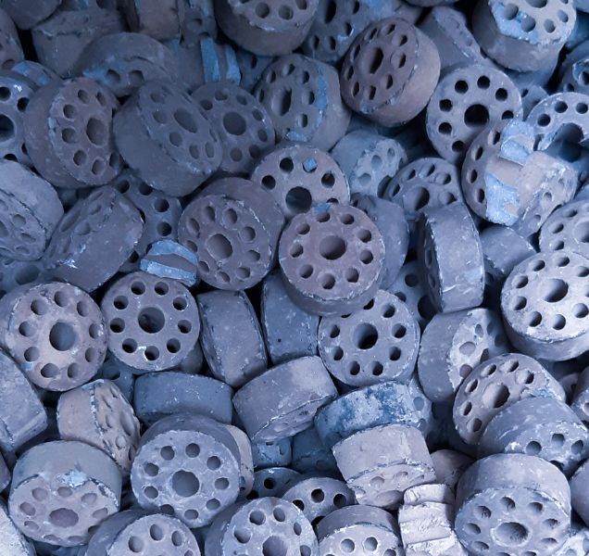

CORPORATE PROFILE
By
Refracast Metallurgicals Pvt Ltd
INDIA

Slide 2
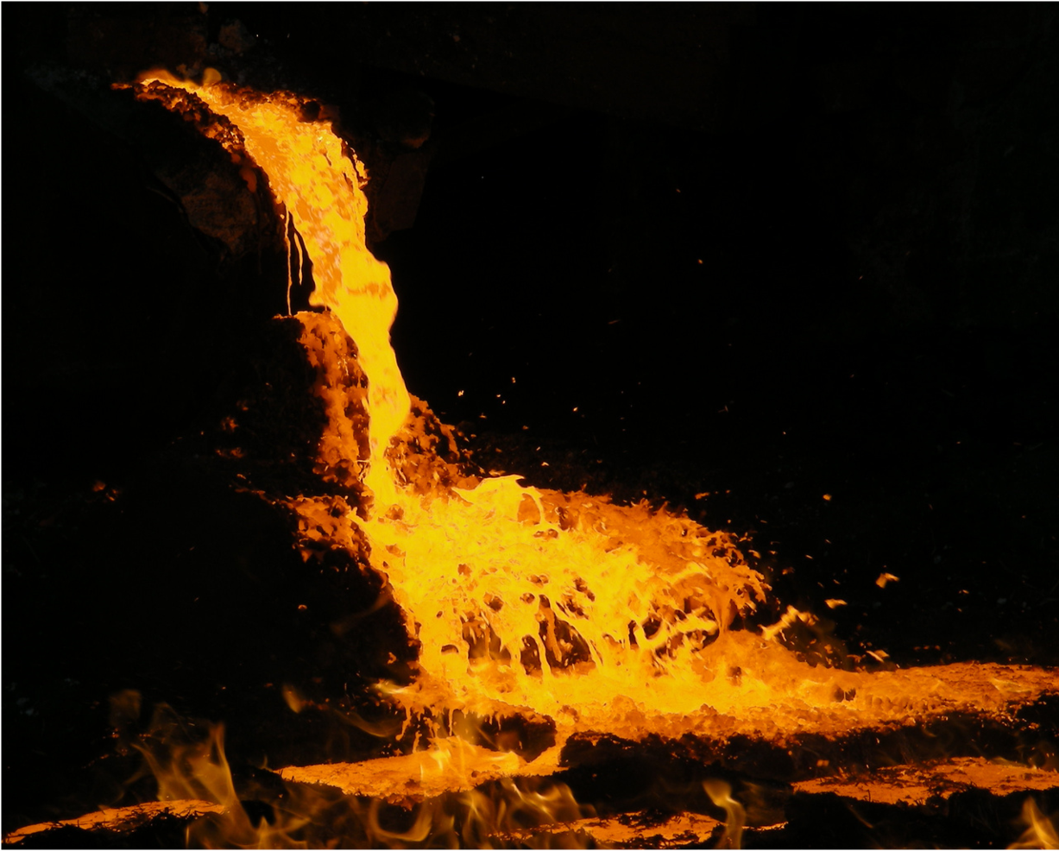

Leading recyclers of Spent Catalyst
We would like to introduce ourselves as "Refracast Metallurgicals Pvt Ltd", pioneer in the field of spent catalyst recycling with more than two decades of recycling experience (based out Raipur ,Chhattisgarh India - Central Province of India), and the better part of which was spent in developing processing capabilities to handle the most complex catalyst.
ISO:9001:2008 Certified Company
Registration No. BN6052/5402:1012
CIN : U24121CT1995PTC009655

Slide 3

COMMITTED TO CLEAN ,GREEN PLANET……
We are pro-actively researching application of our valuable products like Nickel, Cobalt and vanadium in futuristic new generation batteries used in electric vehicles and energy storage space which will be the need of the hour with dwindling fossil fuels and increasing carbon footprints
VISION OF
OUR COMPANY

Slide 4
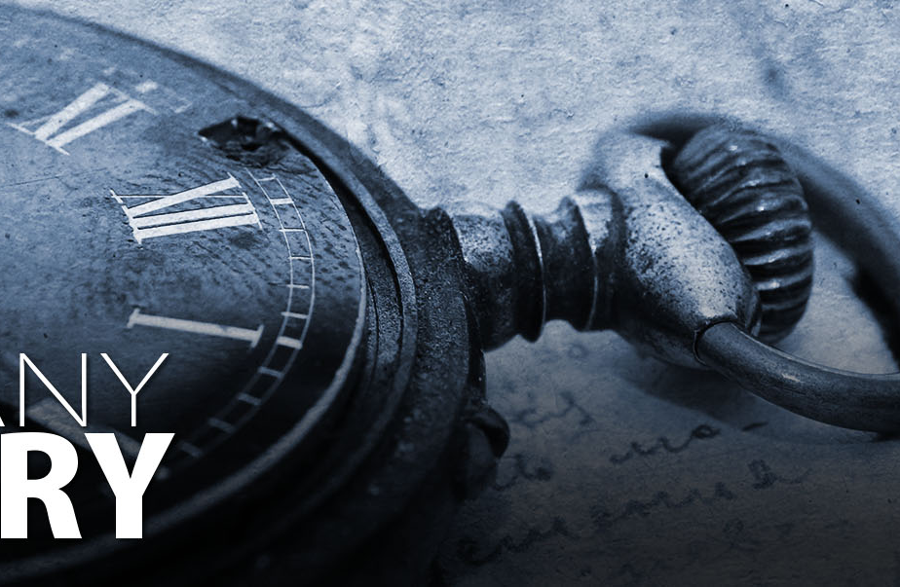
Present day
Setup new unit in the name of Oricon Metallurgicals Pvt Ltd-recognized by Government of India as a STARTUP-unit
COMPANY HISTORY
TIMELINE
2020
Developed in house hydro metallurgy with zero waste technology
our company journey till now
2012
Developed calcium molybdate, ammonium metavanadate, Ammonium para tungstate in India
2010
Received permanent CPCB license for handling hazardous waste
2000
Got first license for processing spent catalyst containing nickel by the government in India
1995
Refracast Metallurgicals Pvt Ltd –RMPL, was Founded in 1995 as a green field project

Slide 5
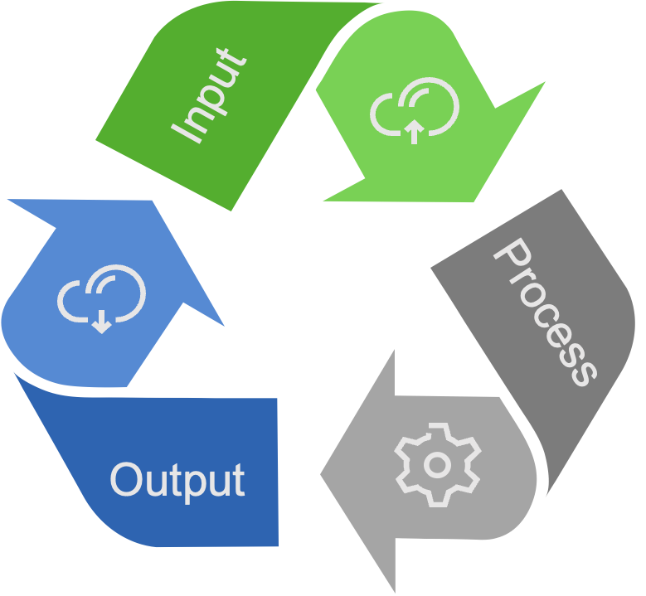
OUR EXPERTISE
We are committed to ZERO WASTE POLICY
ZERO WASTE TECHNOLOGY
CONTRIBUTING TOWARDS CIRCULAR ECONOMY
Limiting the environmental footprint with our ZERO WASTE and NO POLLUTION, manufacturing operation.
.
Using waste and residues including spent catalyst etc. to produce usable products in circular economy.
ENVIRONMENT SAFETY
Committed to
Clean Green
Planet
Environmentally safe solution for processing the Ferrous metal containing waste, residues and catalysts from refineries, fertilizer plants and many more
STATE OF THE ART FACILITY
We have state of the art facility equipped with ETP and all pollution control equipment's as per the norms.

Slide 6


PYROMETALLURGY-
HYDROMETALLURGY
OUR
PROCESS
Hydrometallurgy is alkalic process where waste is digested, precipitated and chemically treated to separate various components .
Pyrometallurgy is heat treatment process applied to the waste products and material is separated at molten state.
Breaking
Sieving
Palletizing
Breaking
Mixing
Thermal
Treatment
Roasted
Products
Testing
Alloys &
Oxides
Alloys &
Oxides
Refining
Leaching /
Smelting
WE DO NOT GENERATE ANY WASTE

Slide 7
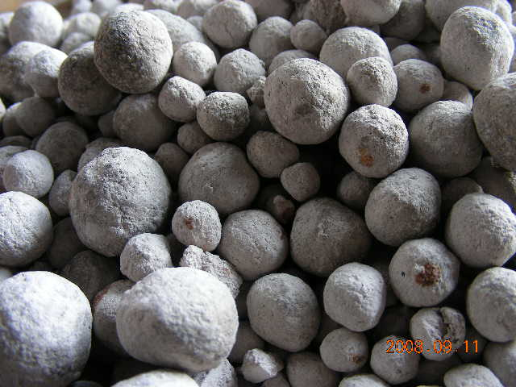
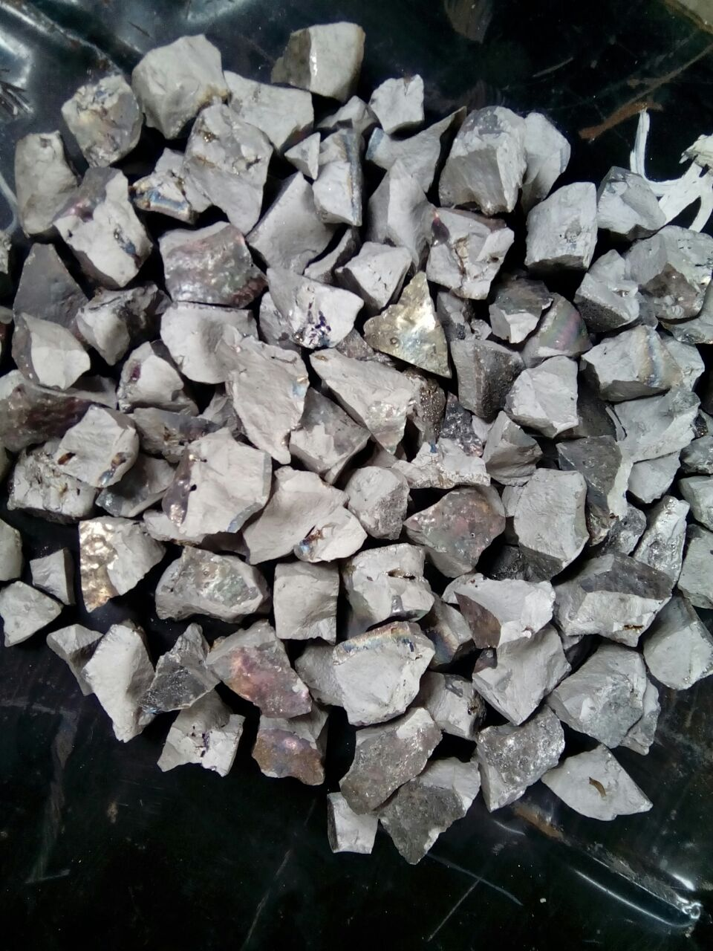
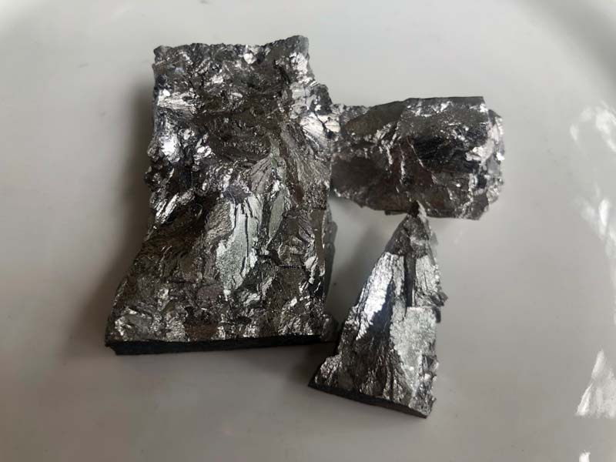
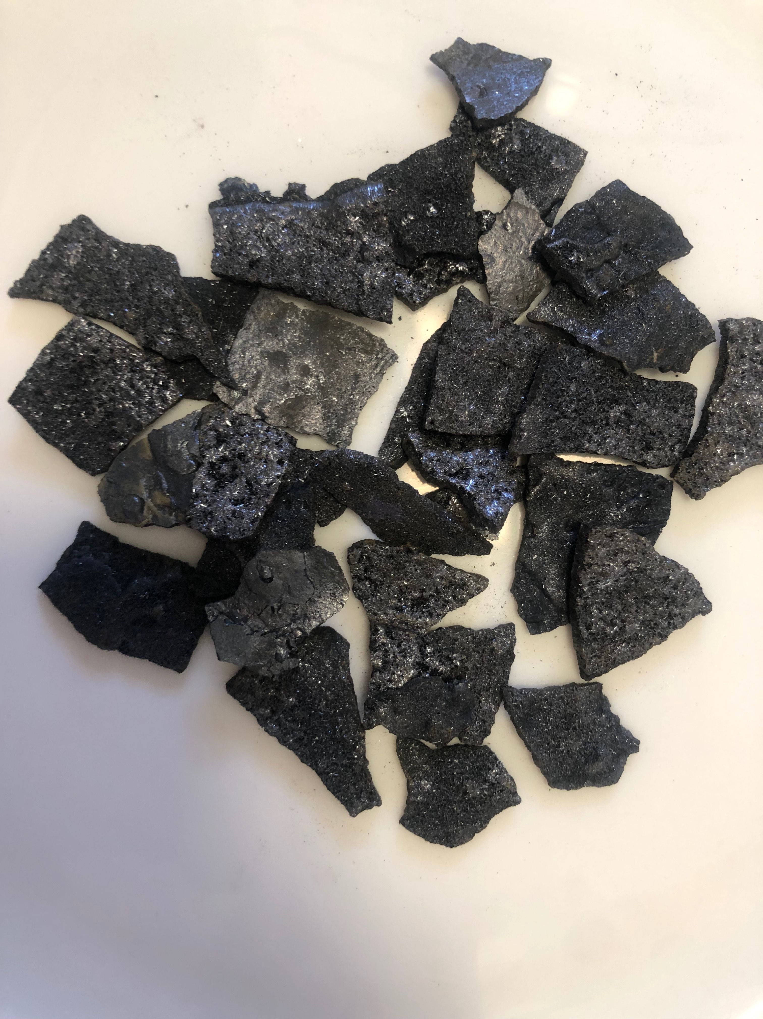
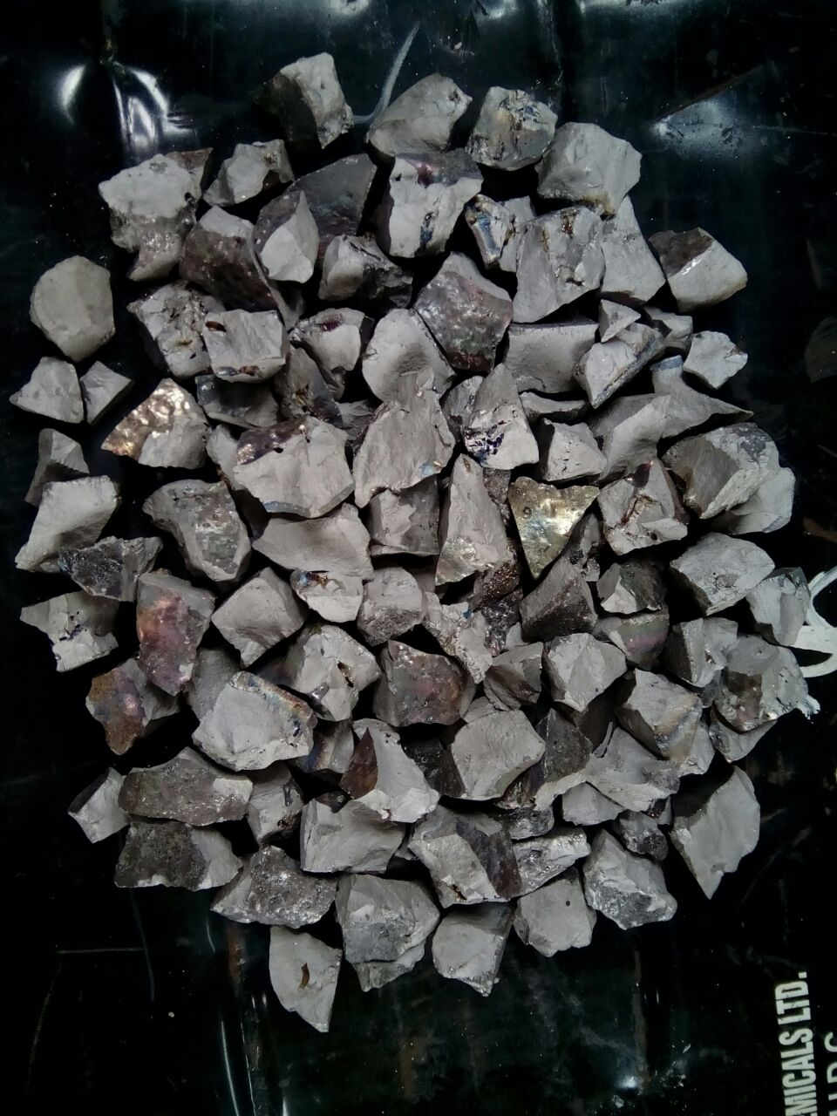
We process spent catalysts and residues containing metals, recycling them into a range of specialty products. These products are manufactured based on tailored specifications and is in accordance with global standards.
Calcium
Molybdate
Ferro Tungsten
Molybdenum
Ferro
Vanadium
OUR PRODUCTS
Vanadium
Flakes
Ferro
Tungsten

Slide 8
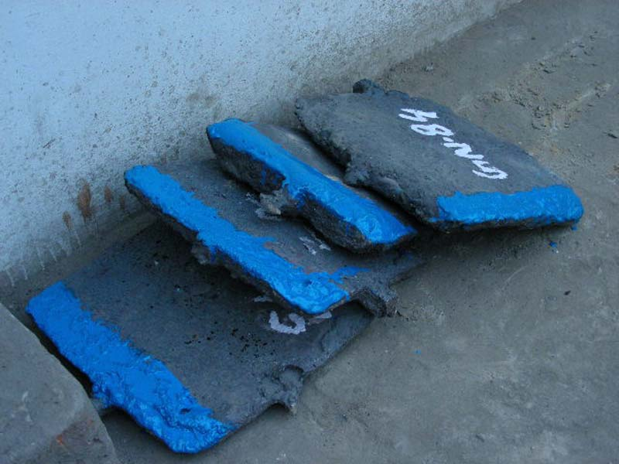
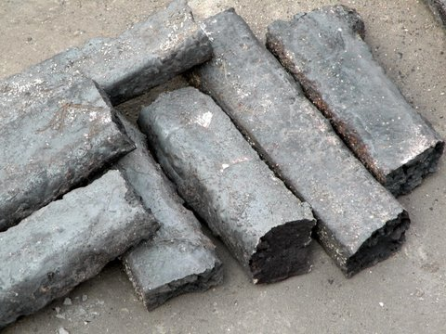
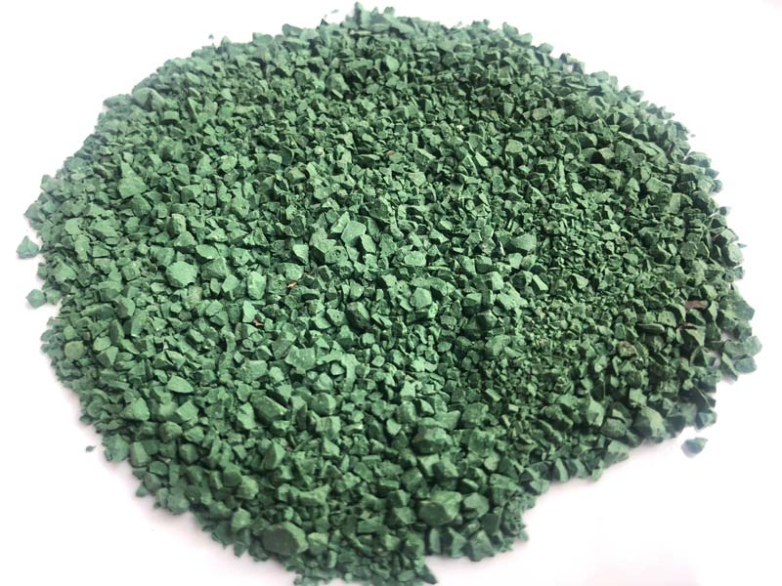
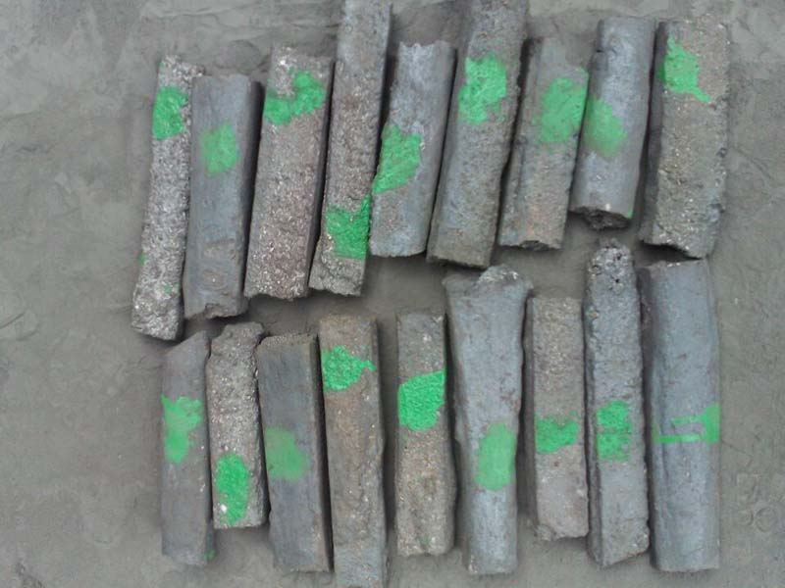
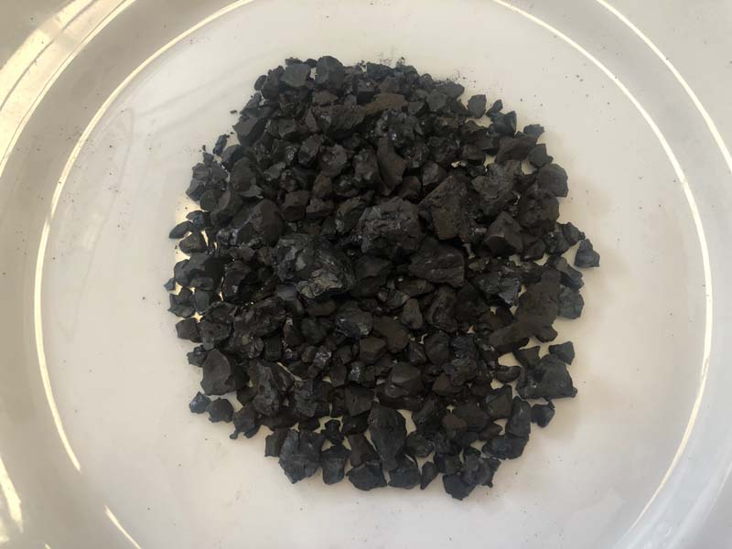
Our products are used mainly in steel plants , refractories , paint industries, ceramic units, induction furnace units and casting units.
Ferro Cobalt
Molybdenum
Ferro
Nickel
Nickel Oxide &
Hydroxide
OUR PRODUCTS
Ferro Nickel
Moly
Cobalt oxide &
Hydroxide

Slide 9
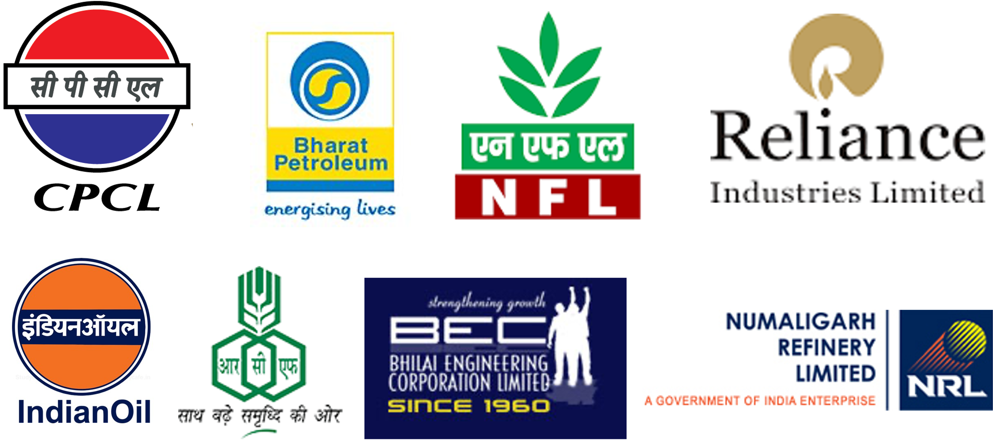




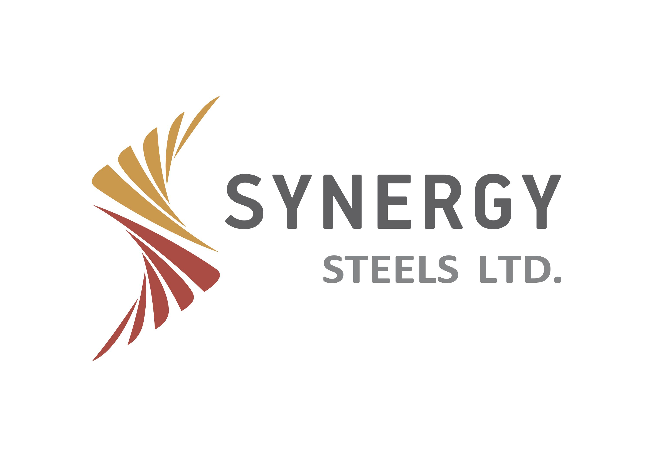
Our Associates
Our commitment to excellence and customer satisfaction is evident in every interaction. We prioritize understanding the unique needs of each client, ensuring tailor-made solutions that meets the expectations.
set this
AND MORE……

Slide 10
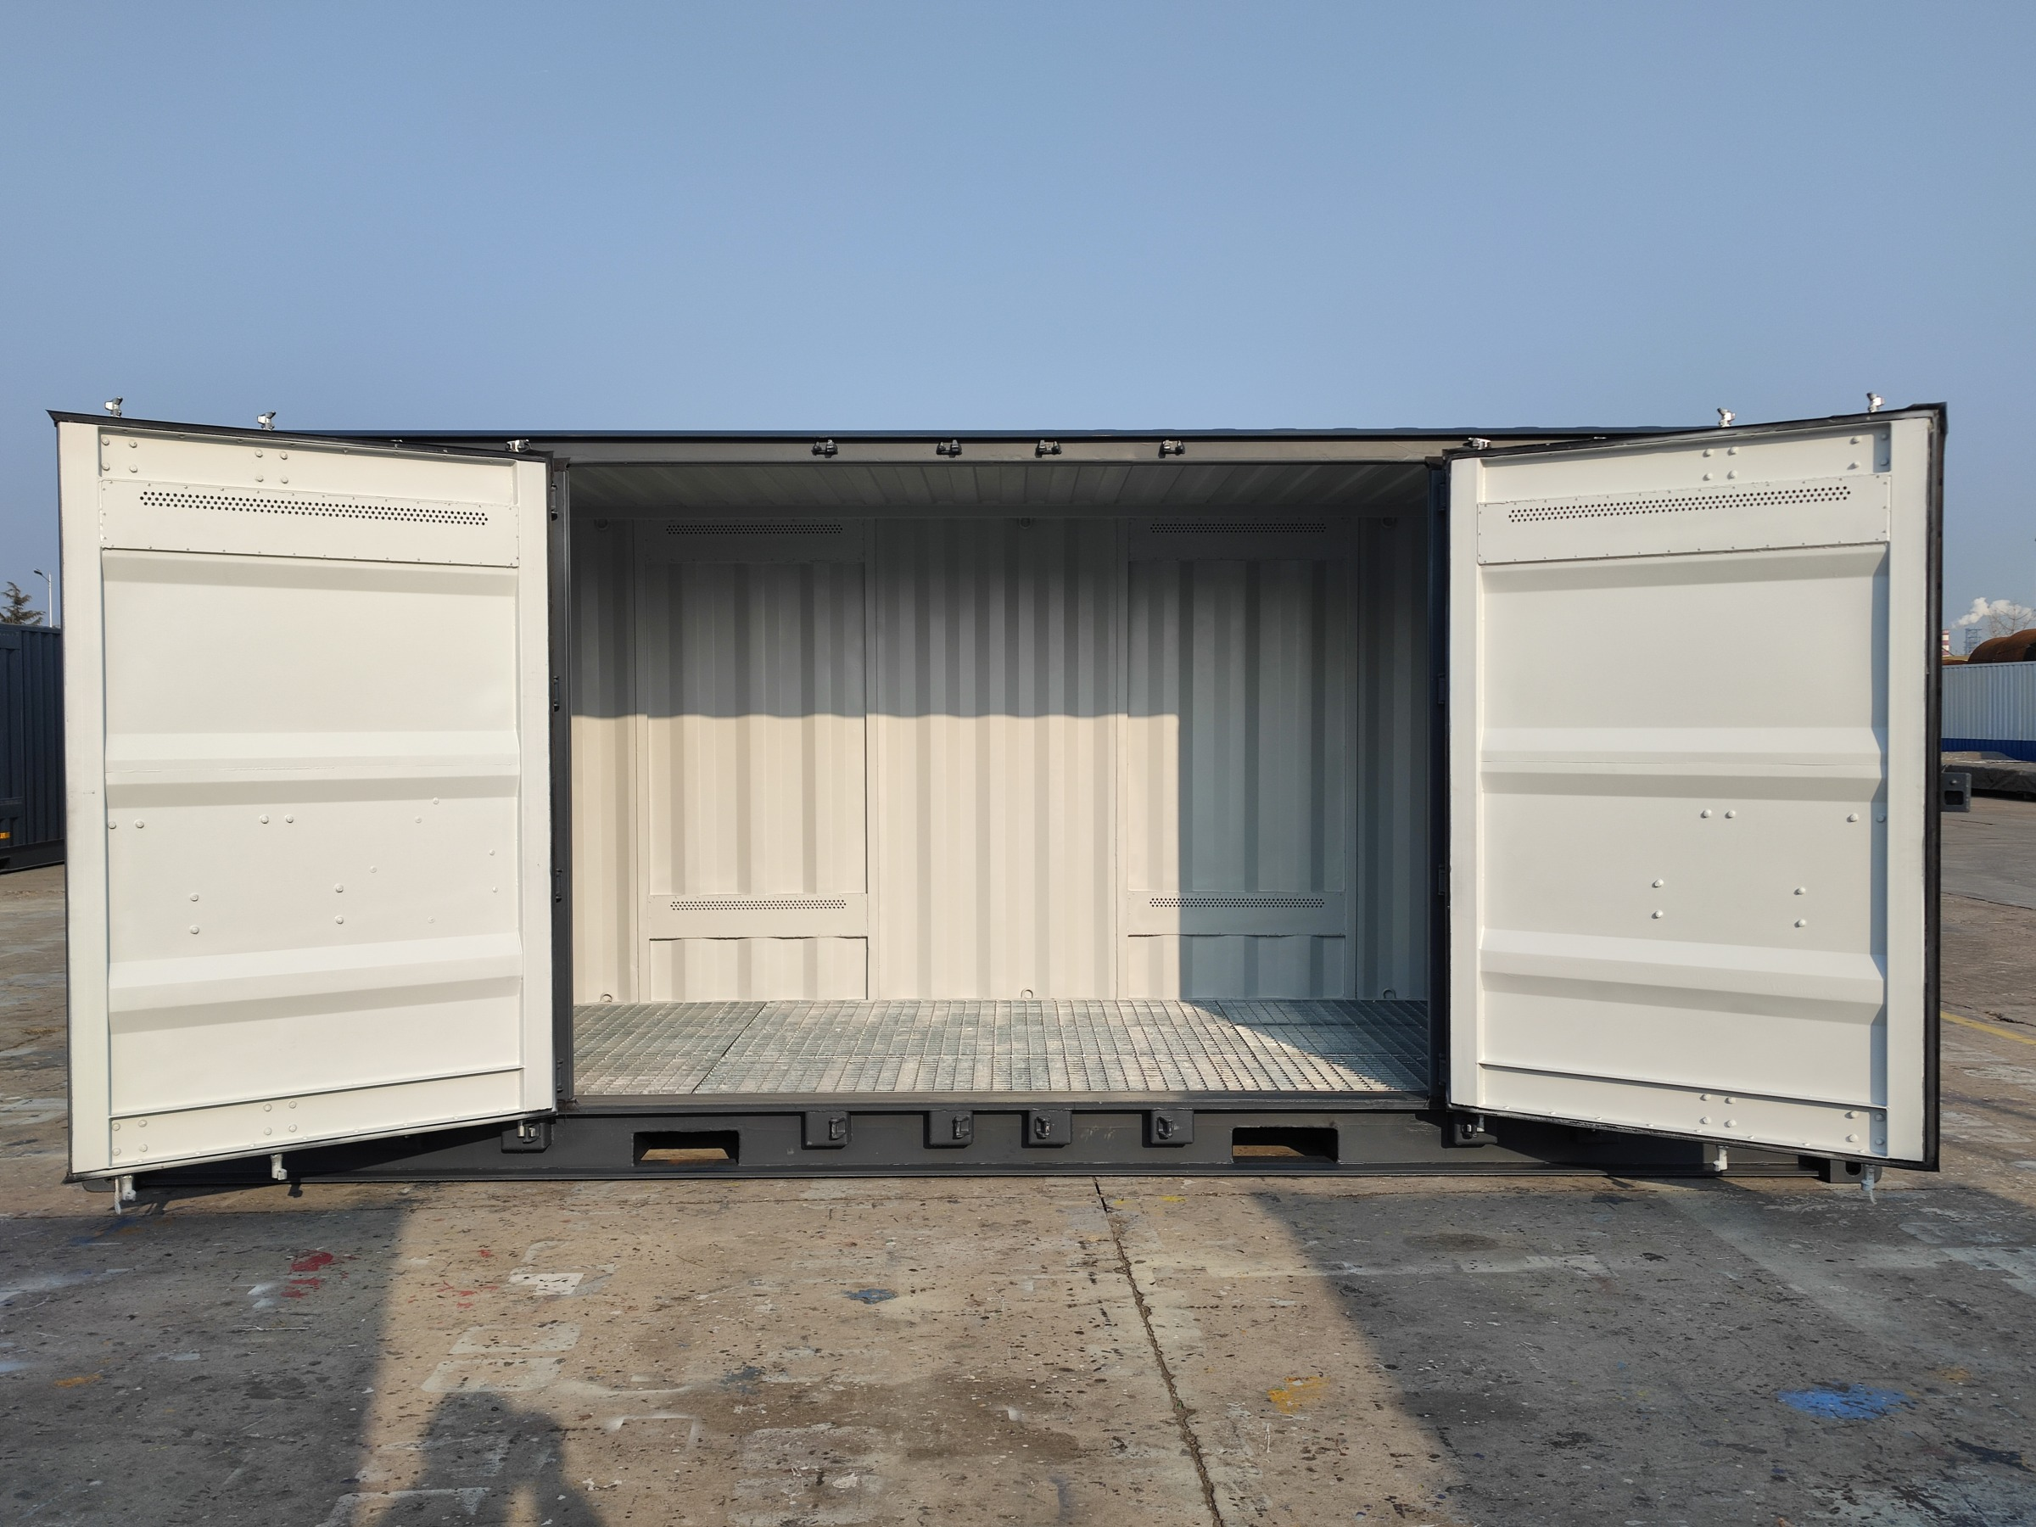
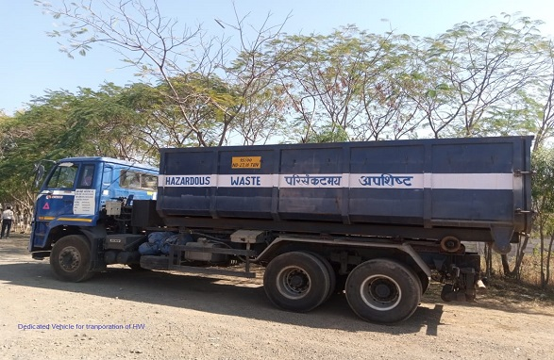
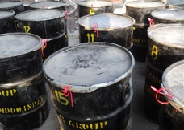
We follow the norms and procedures laid down by Government of India, which in turn is governed by BASEL Convention Norms for Hazardous Waste Management and Recycling. Accordingly, we has been given permanent registration and authorization by Environmental Conservation board under the Ministry of Environment , Forest & Climate Change , Govt. Of India (MOEF&CC) to procure, process and dispose the products of Hazardous Waste .
TRANS
BOUNDARYMOVEMENT

Slide 11
STAGE-1
NOTIFICATION
GENERATOR
PROCESSOR/RECYCLER
Agreement between the two entities specifying the ESM
Inform about the proposed movement
COUNTRY
OF EXPORT
COUNTRY
OF IMPORT
Send the notification documents
TRANS
BOUNDARYMOVEMENT
ENVIORNMENTALLY SOUND MANAGEMENT-ESM
AS PER BASEL CONVENTION

Slide 12
STAGE-2
CONSENT & MOVEMENT
GENERATOR
PROCESSOR/RECYCLER
Issue movement documents
COUNTRY
OF EXPORT
COUNTRY
OF IMPORT
Written consent for the movement
TRANS
BOUNDARYMOVEMENT
ENVIORNMENTALLY SOUND MANAGEMENT-ESM
AS PER BASEL CONVENTION

Slide 13
STAGE-3
TRANSBOUNDARY MOVEMENT
GENERATOR
PROCESSOR/RECYCLER
Shipping- Sending copy of movement document confirming the shipment
COUNTRY
OF EXPORT
COUNTRY
OF IMPORT
TRANS
BOUNDARYMOVEMENT
ENVIORNMENTALLY SOUND MANAGEMENT-ESM
AS PER BASEL CONVENTION

Slide 14
STAGE-4
DISPOSAL CONFIRMATION
GENERATOR
PROCESSOR/RECYCLER
INFORMING ABOUT THE DISPOSAL
COUNTRY
OF EXPORT
COUNTRY
OF IMPORT
TRANS
BOUNDARYMOVEMENT
ENVIORNMENTALLY SOUND MANAGEMENT-ESM
AS PER BASEL CONVENTION

Slide 15
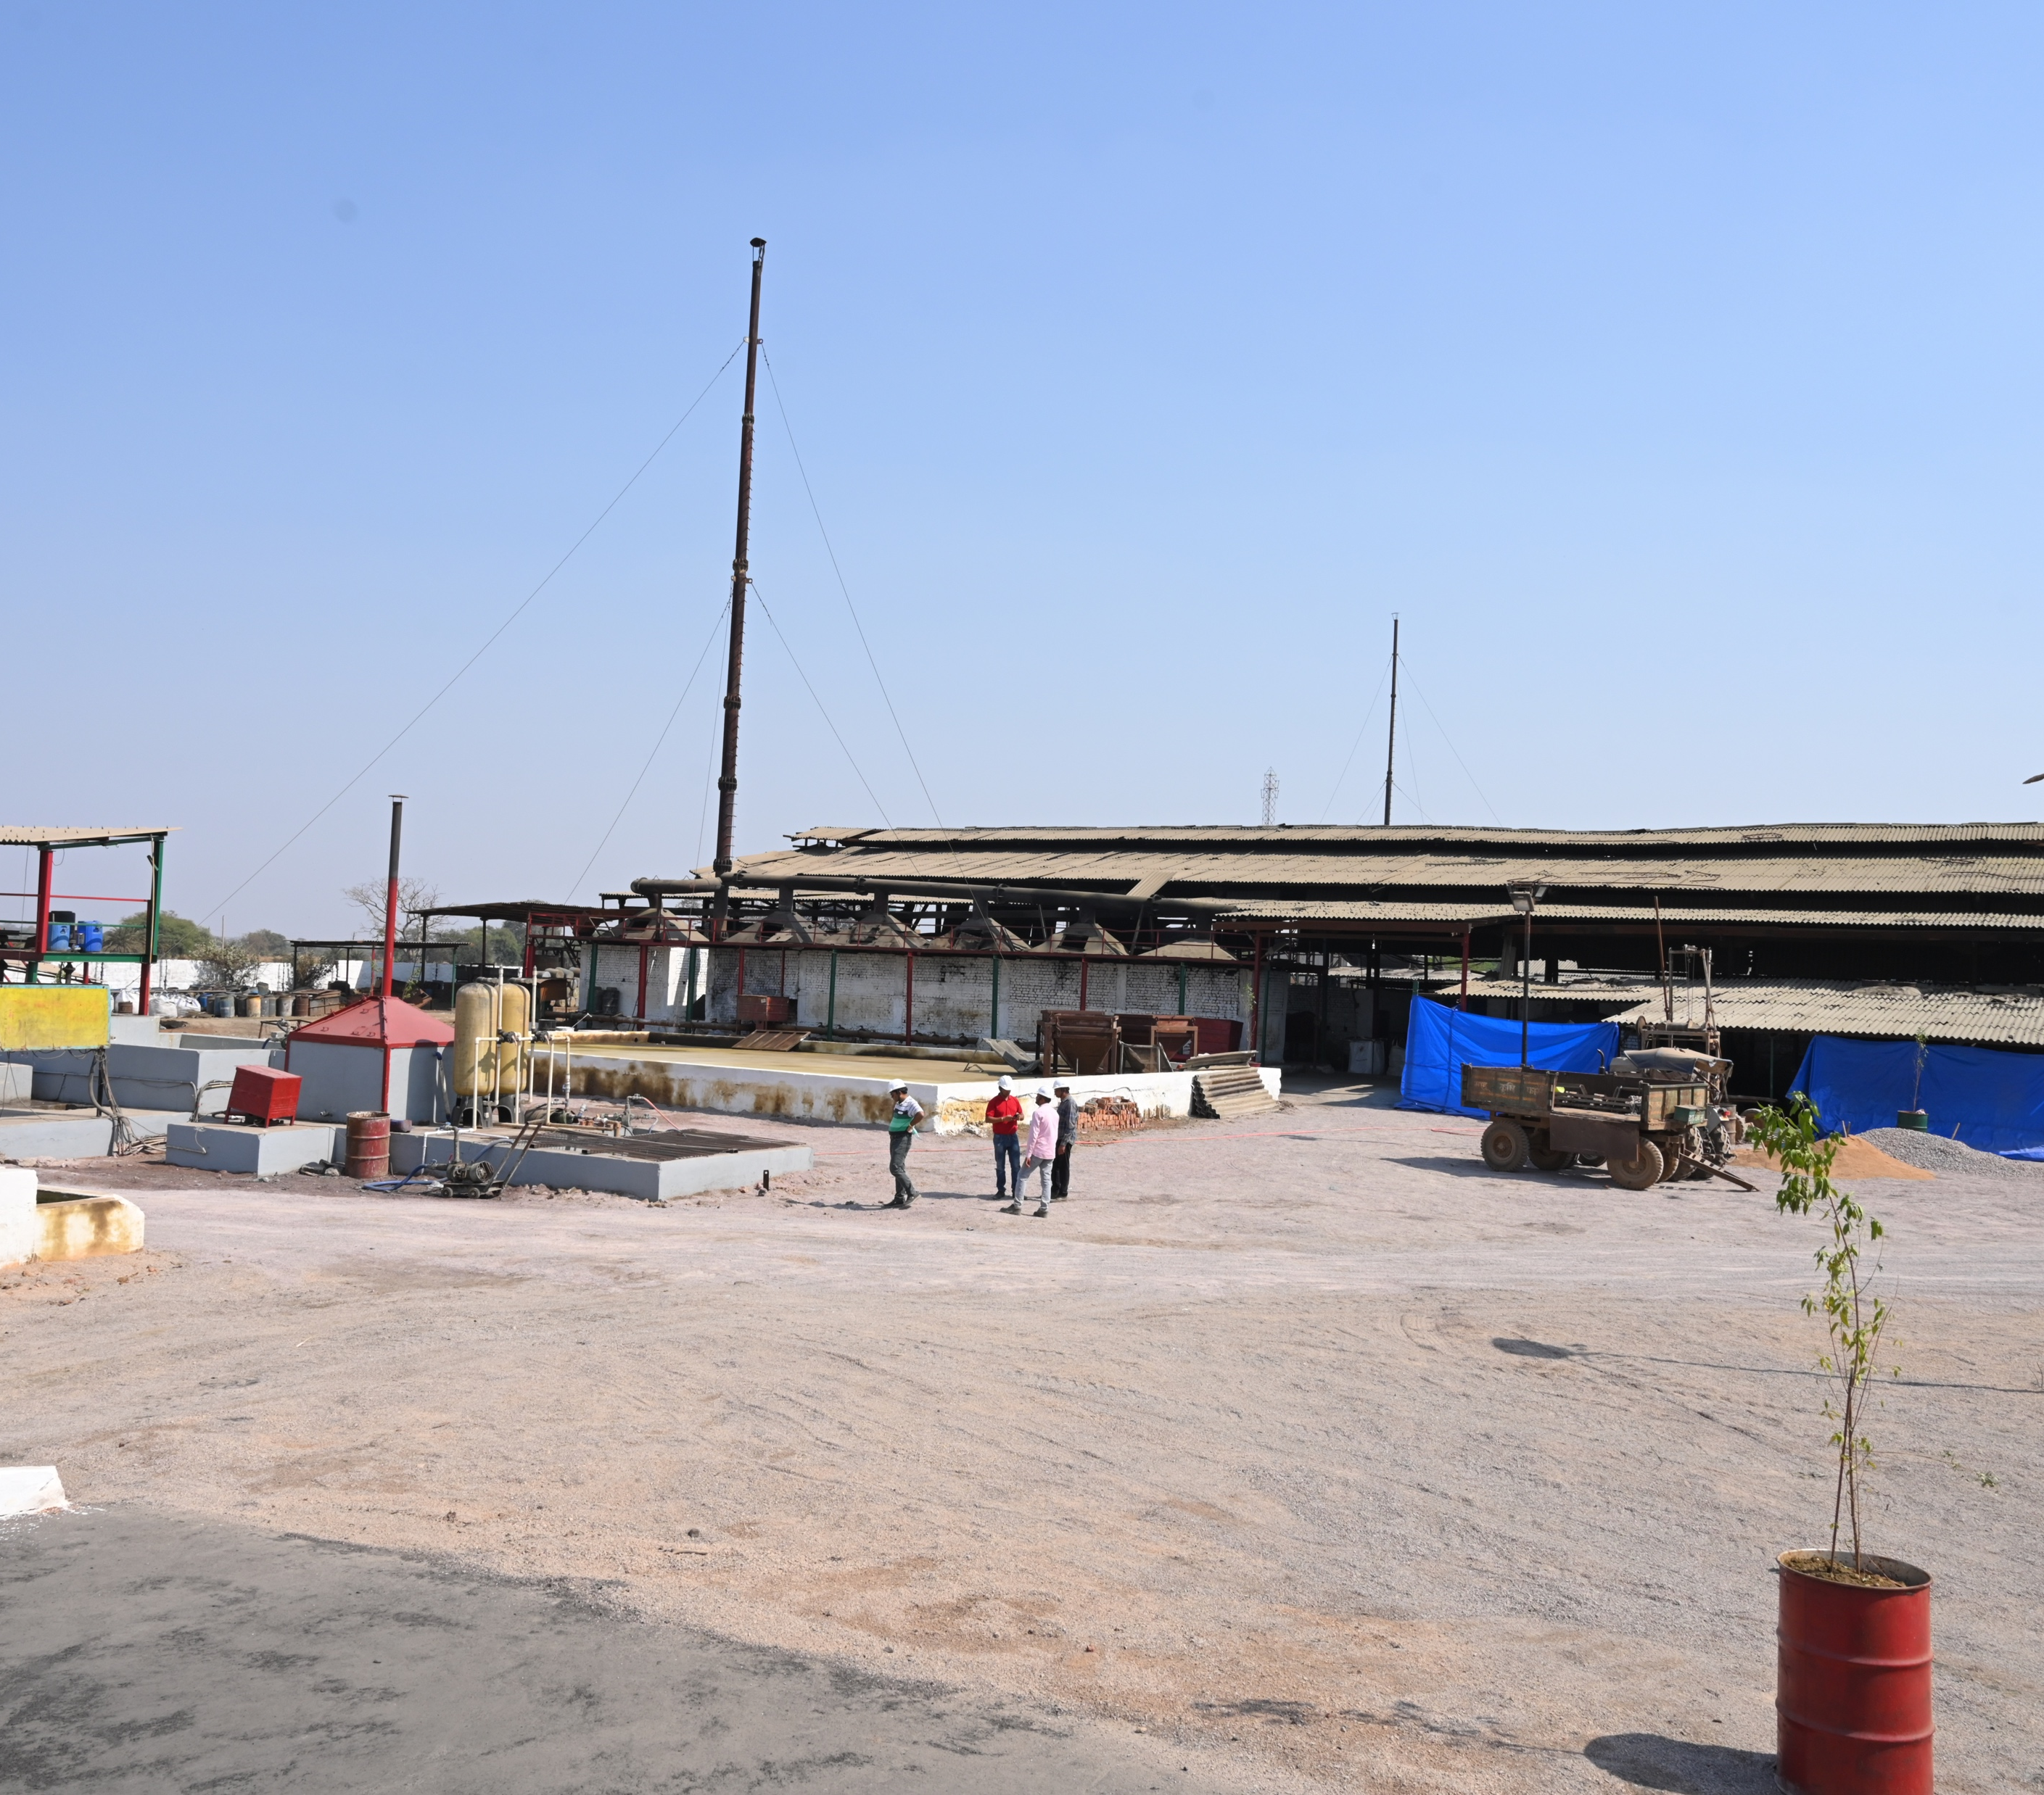
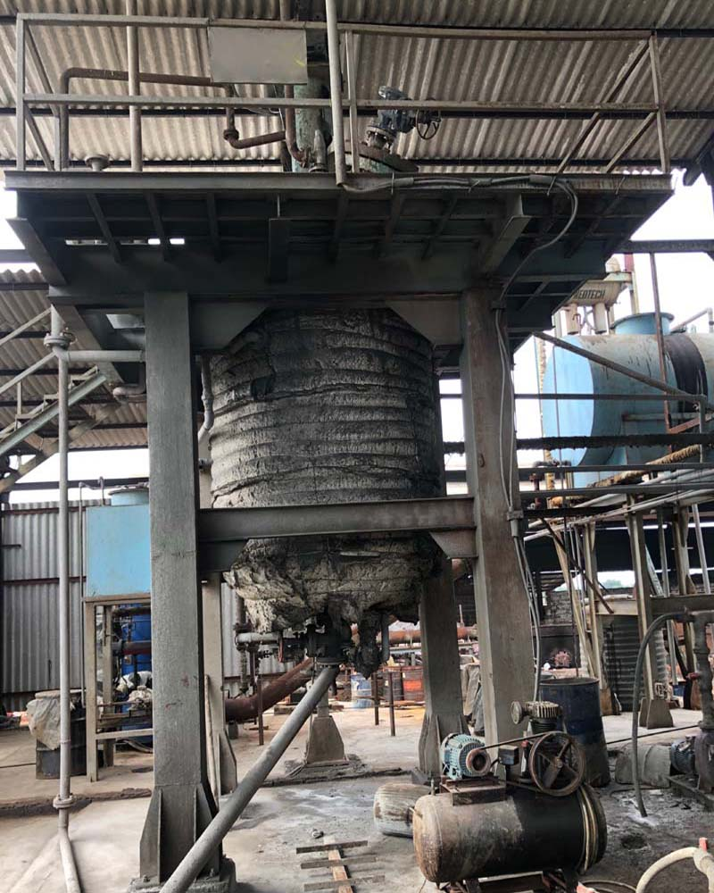
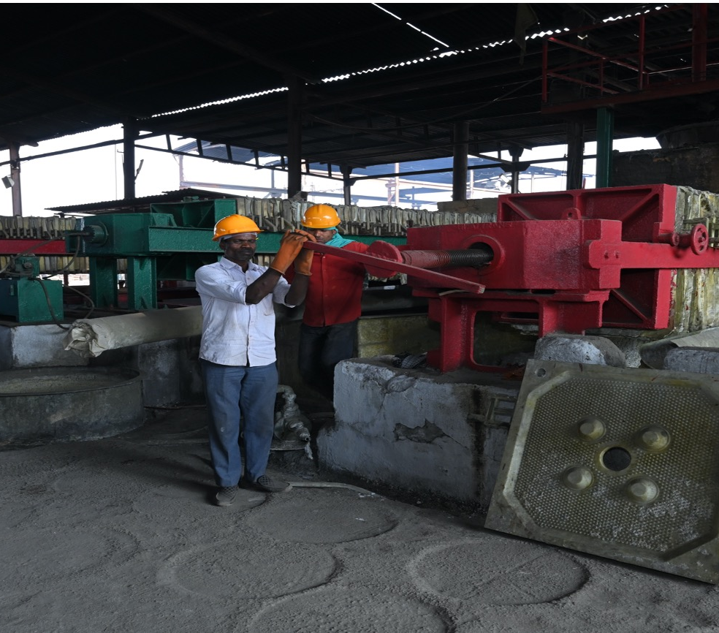
OUR PLANT
GALLERIES

Slide 16
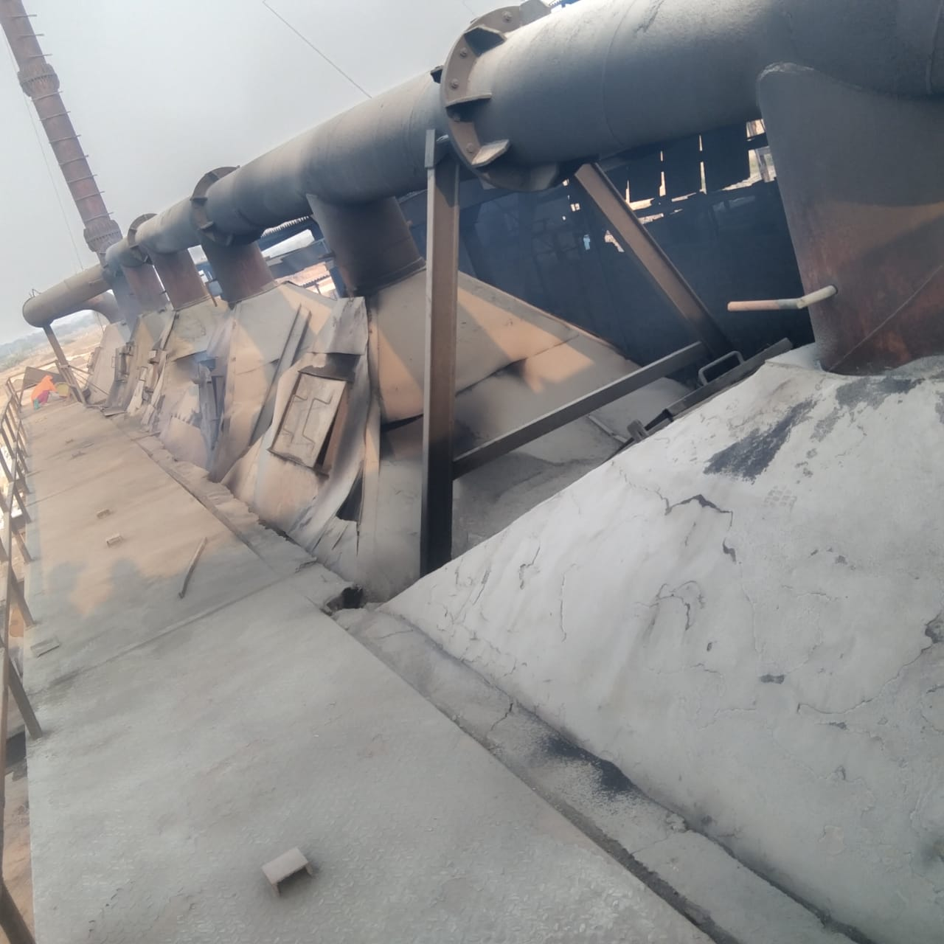
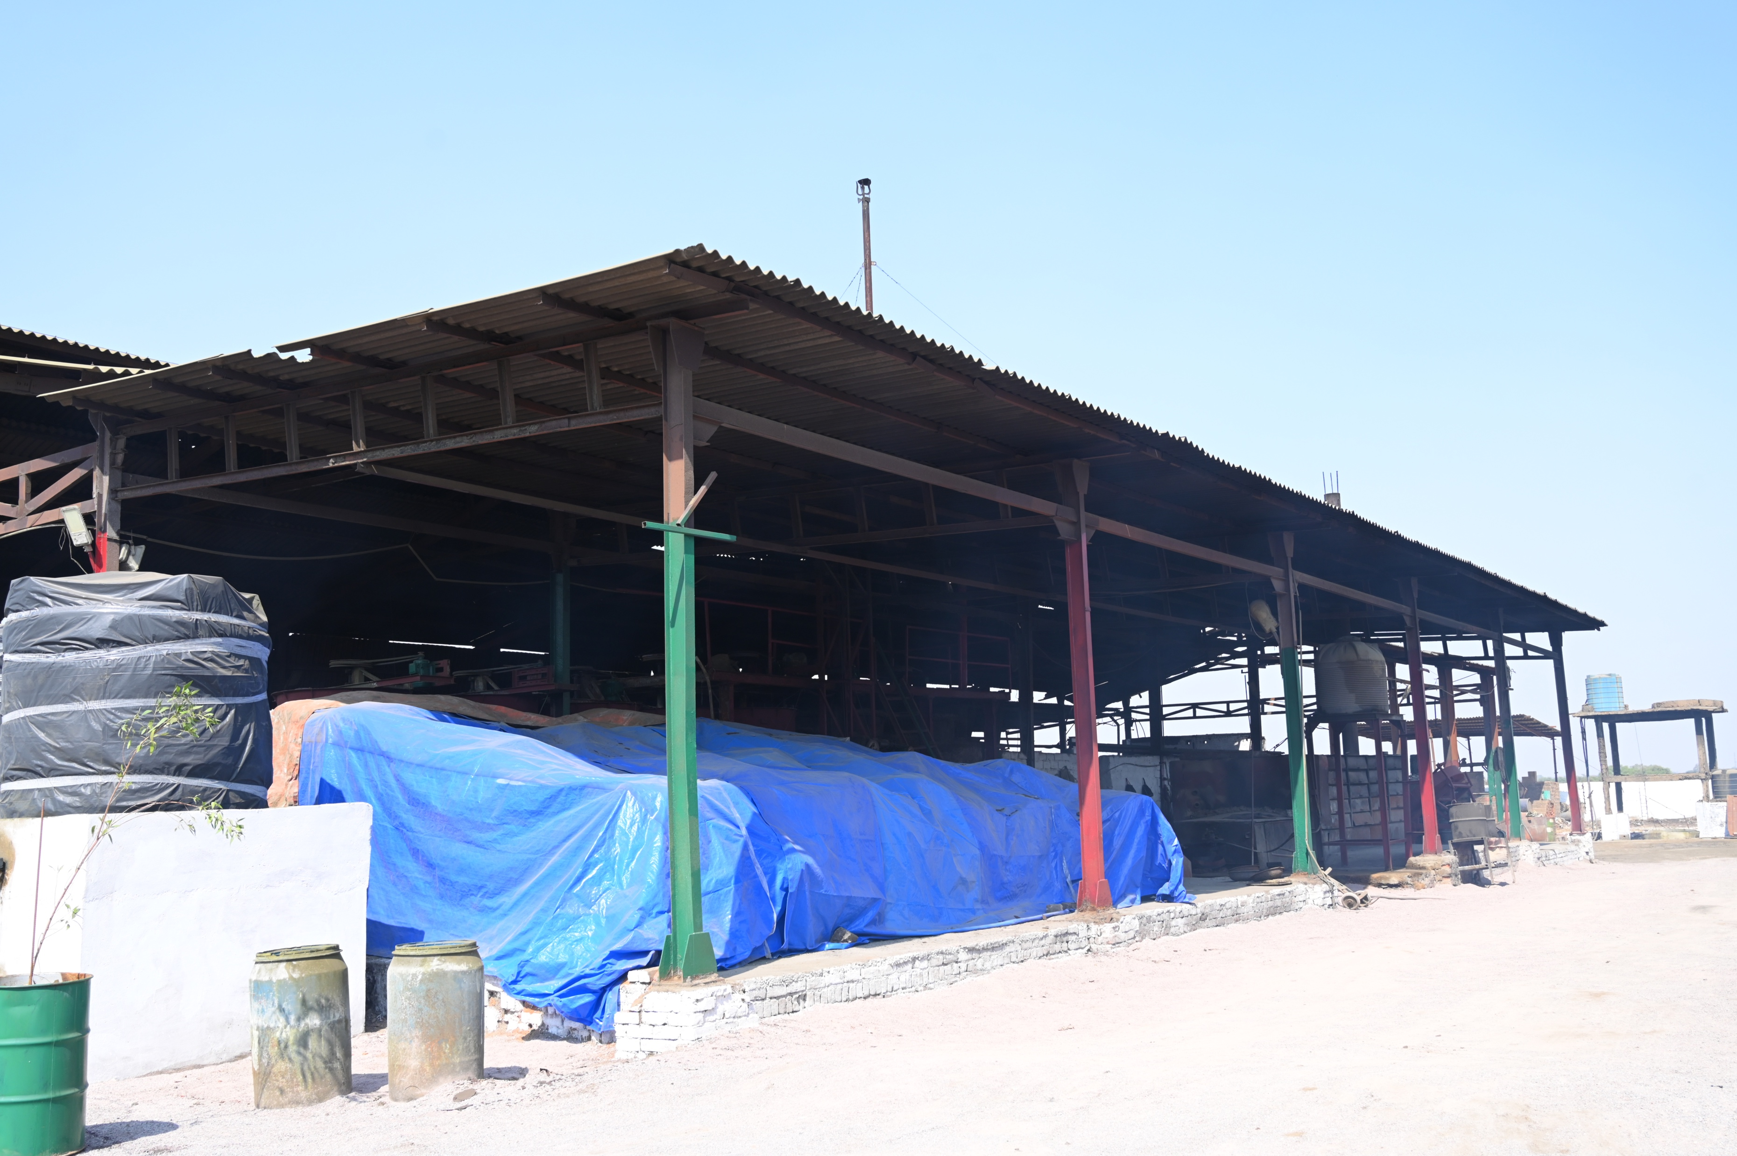
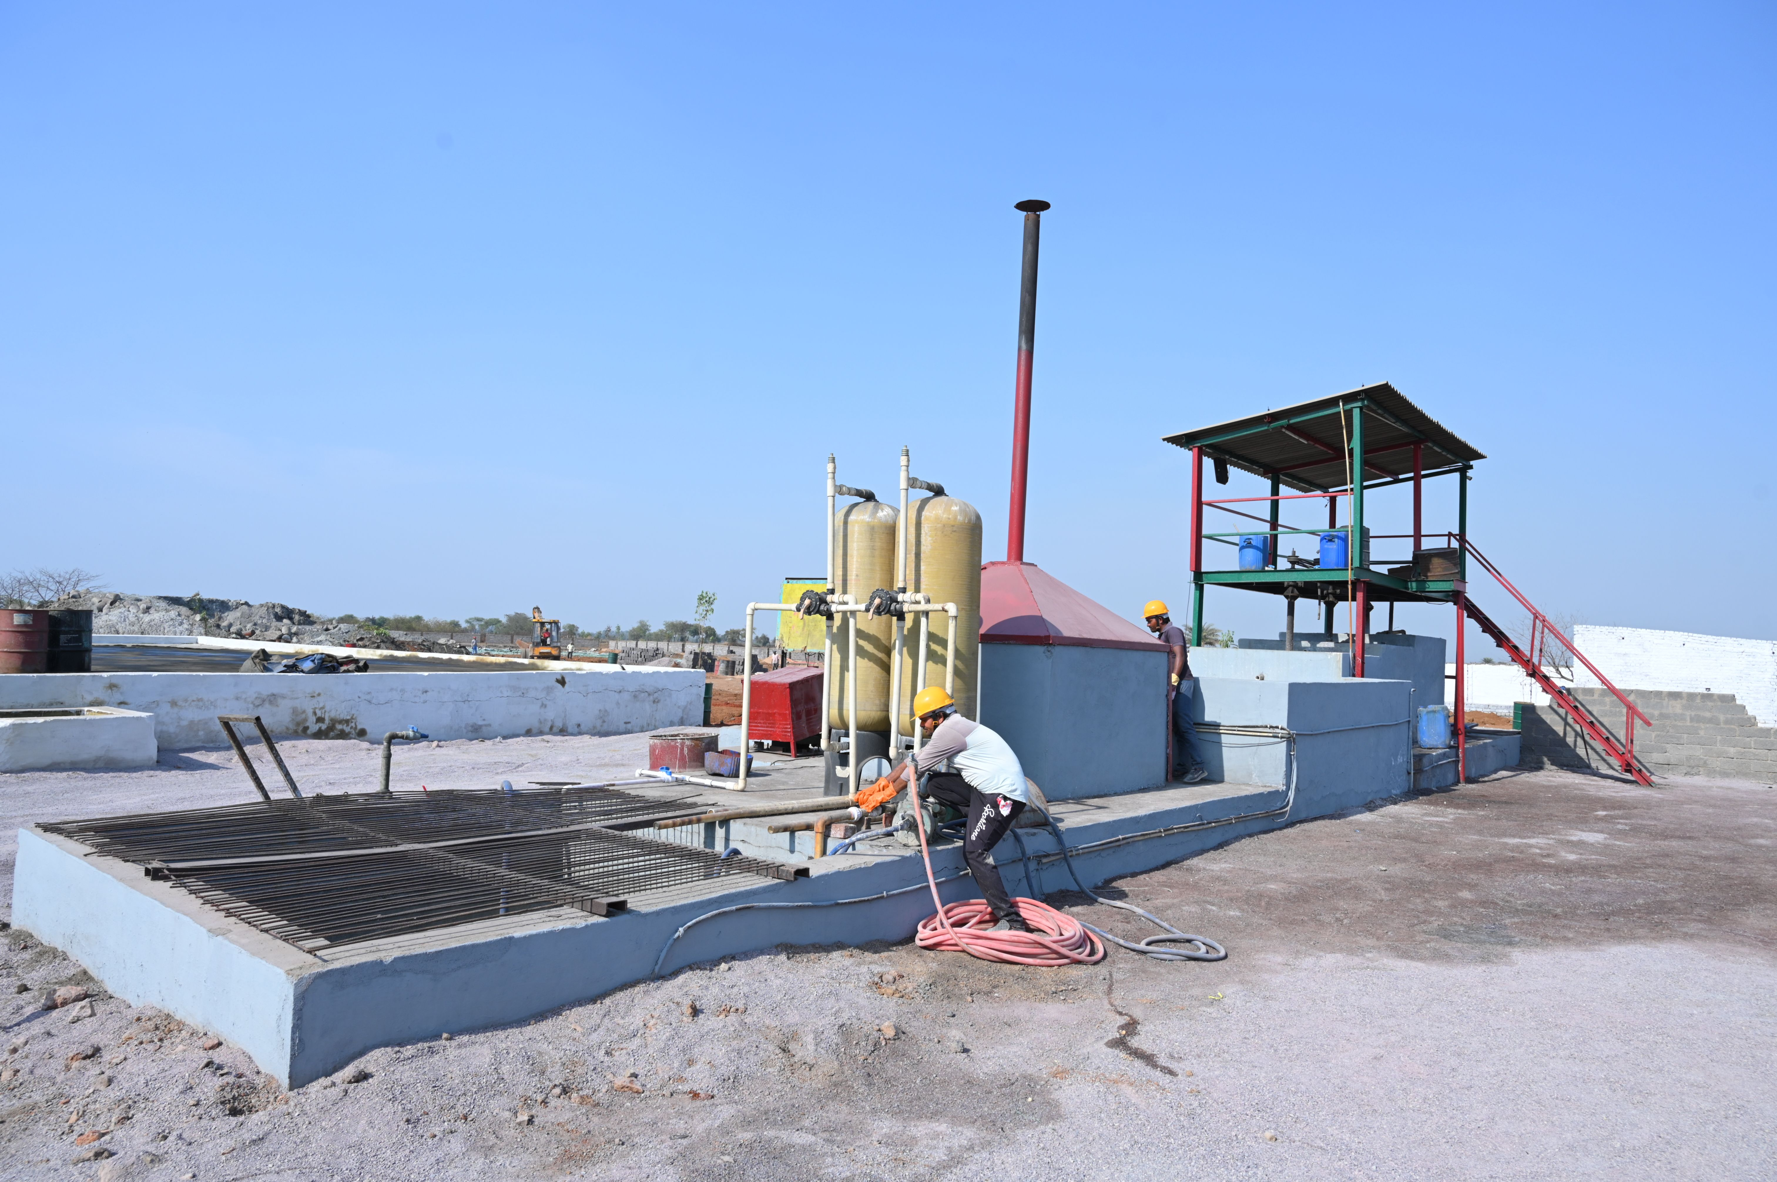
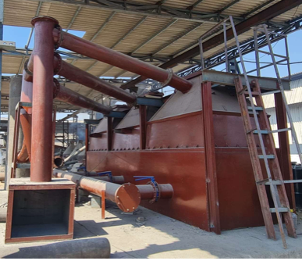
OUR PLANT
GALLERIES

Slide 17
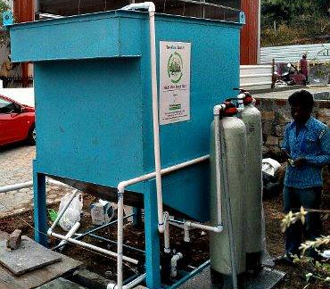
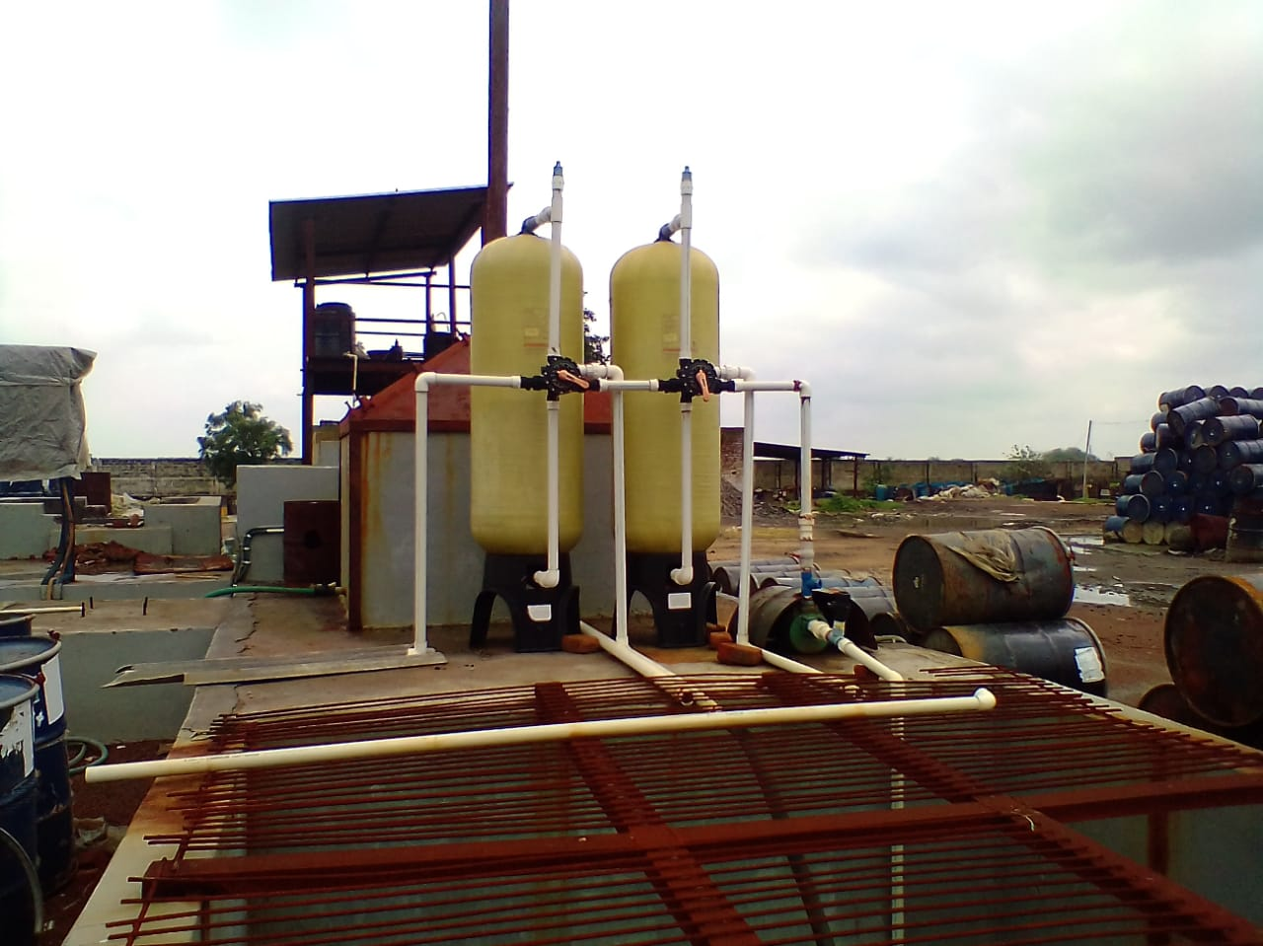
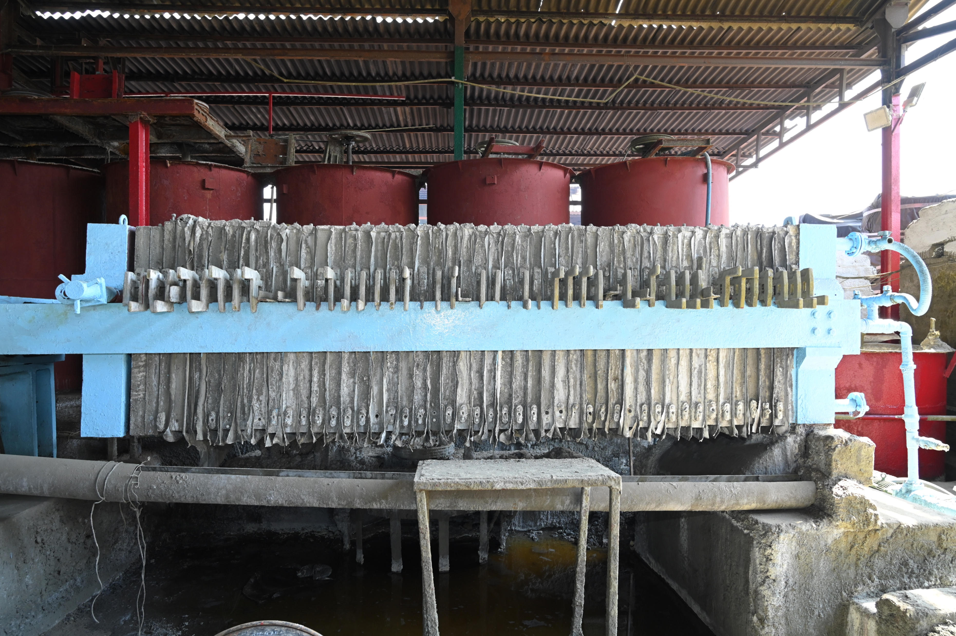
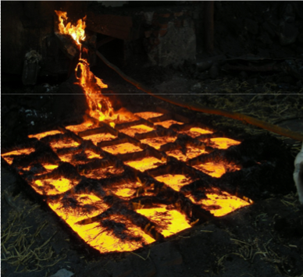
OUR PLANT
GALLERIES

Slide 18
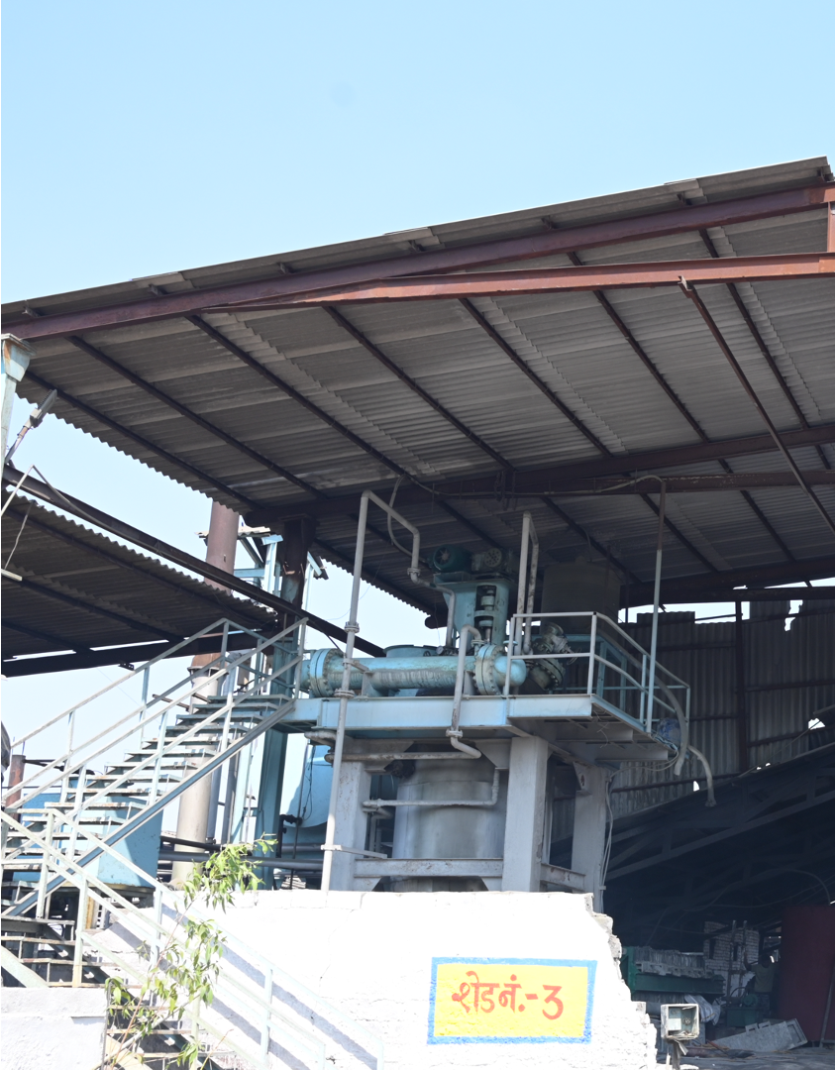
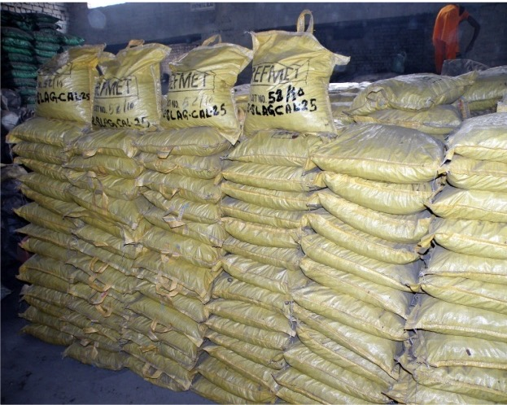
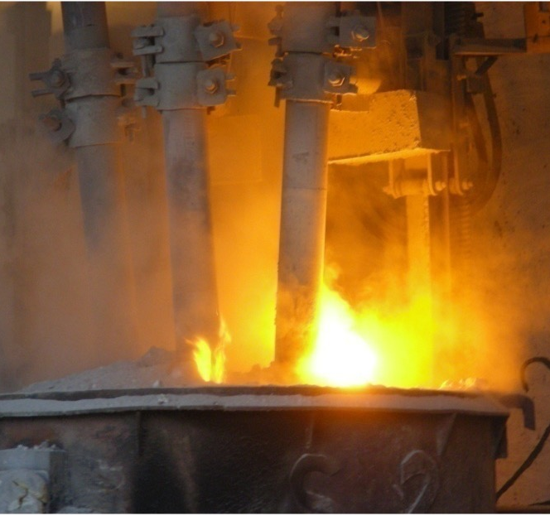
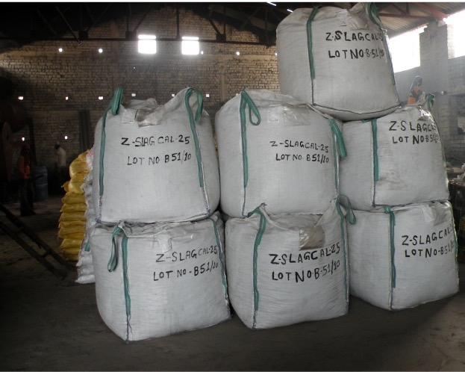
OUR PLANT
GALLERIES

Slide 19
OUR PRESENCE
CANADA
NETHERLANDS
Our footprint extends across India , Canada, Netherlands and Taiwan and with a strong and dynamic presence, we continue to positioning ourselves as a key player in the recycling and metal reclamation space.
INDIA
TAIWAN

Slide 20
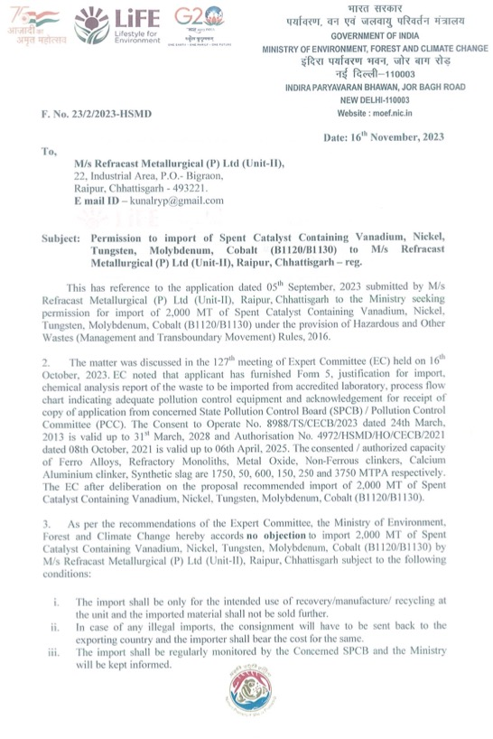
OUR APPROVALS
PERMISSION TO IMPORT SPENT CATALYST FROM MINISTRY OF ENVIRONMENT AND CLIMATE CHANGE , GOVERNMENT OF INDIA
set this

Slide 22
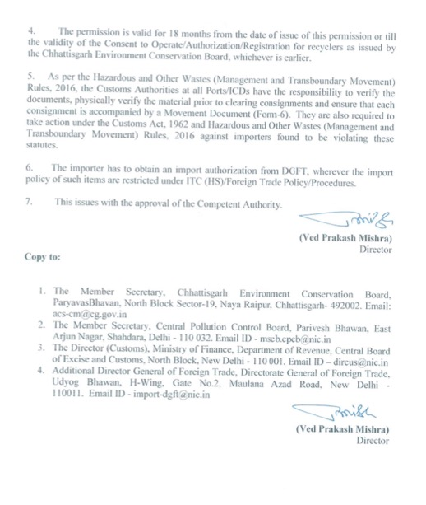
OUR APPROVALS
PERMISSION TO IMPORT SPENT CATALYST FROM MINISTRY OF ENVIRONMENT AND CLIMATE CHANGE , GOVERNMENT OF INDIA
set this

Slide 23
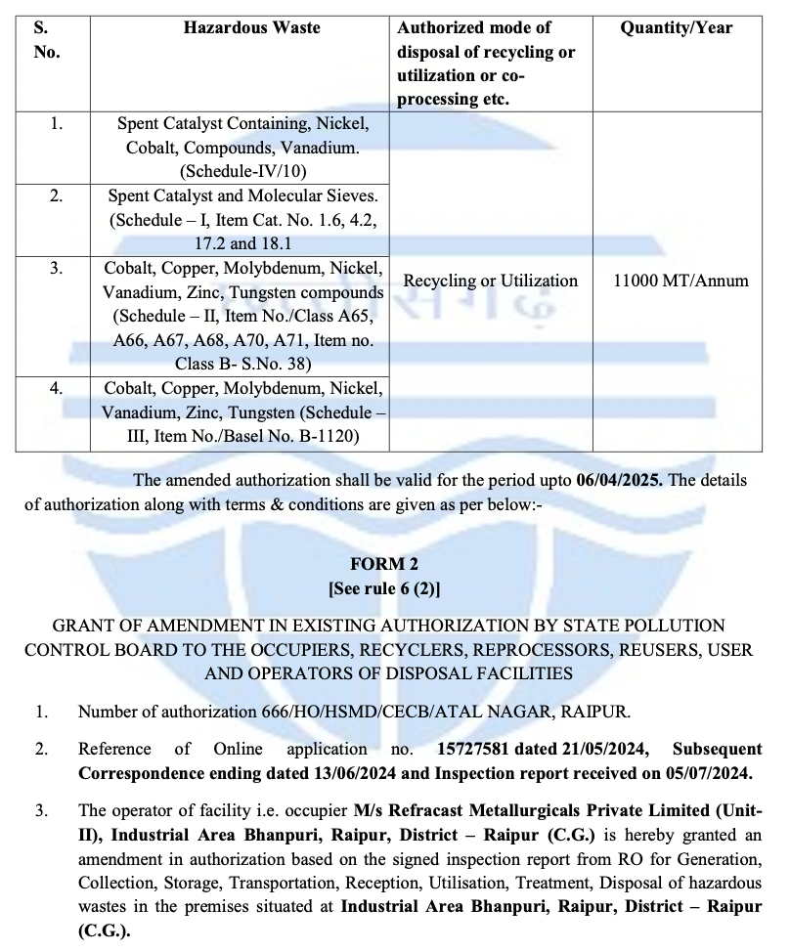
OUR APPROVALS
HAZARDOUS WASTE
AUTHORIZATION
VALID UPTO
06-04-2025
set this

Slide 24
OUR APPROVALS
AIR AND WATER
CONSENT
VALID UPTO 31-03-2028
set this

Slide 25
OUR APPROVALS
APPROVAL OF IMPORT FROM DIRECTORATE GENERAL OF FOREIGN TRADE , GOVERNMENT OF INDIA
set this

Slide 26

OUR CONTACT
DETAILS
REFRACAST METALLURGICALS PVT LTD
ASHOKA PARK BUILDING
KUTCHANA ROAD ,SHANKAR NAGAR RAIPUR –CHHATTISGARH-INDIA-492007
www.refemt.org

